Slide 1
Software Testing Methodologies
Definition: Methodologies can be considered as the set of testing mechanisms used in software development lifecycle from Unit Testing to System Testing. Selecting an appropriate testing methodology is the core of the testing process.
Below are the Testing Techniques
White Box Testing
Black Box Testing
Gray Box Testing

Slide 2
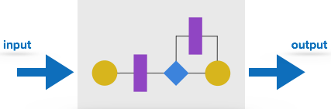
What is White Box Testing?
White box testing technique is used to examine the program structure and business logic, it validates the code or program of an application. It is also called as Clear Box Testing, Glass Box Testing or Open Box Testing.
White Box Testing Techniques include:
Statement Coverage: Examines all the programming statements.
Branch Coverage: Series of running tests to ensure if all the branches are tested.
Path Coverage: Tests all the possible paths to cover each statement and branch.

Slide 3
White Box testing Pros and Cons
Advantages | Disadvantages
As the tester has knowledge of the source code, it becomes very easy to find out which type of data can help in testing the application effectively. | Since a skilled tester is needed to perform white-box testing, the costs are increased.
It helps in optimizing the code. | Sometimes it is impossible to investigate every nook and corner to find out hidden errors that may create problems, as many paths will go untested.
Extra lines of code can be removed which can bring in hidden defects. | It is difficult to maintain white-box testing, as it requires specialized tools like code analyzers and debugging tools.
Due to the tester's knowledge about the code, maximum coverage is attained during test scenario writing.

Slide 4
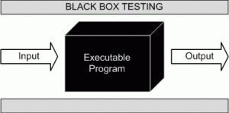
What is Black Box testing?
Black Box testing method is used to test the functionality of an application based on the requirement specification. Unlike White Box Testing it does not focus on internal structure/code of the application.
Black Box Techniques include:
Boundary Value analysis
Equivalence Partitioning (Equivalence Class Partitioning)
Decision Tables
State Transition
Error Guessing

Slide 5
Black Box testing Pros and Cons
Advantages | Disadvantages
Well suited and efficient for large code segments. | Limited coverage, since only a selected number of test scenarios is performed.
Code access is not required. | Inefficient testing, since the tester only has limited knowledge about an application.
Clearly separates user's perspective from the developer's perspective through visibly defined roles. | Blind coverage, since the tester cannot target specific code segments or errorprone areas.
Large numbers of moderately skilled testers can test the application with no knowledge of implementation, programming language, or operating systems. | The test cases are difficult to design.

Slide 6
Grey Box Testing:
This method of testing is performed with less information about the internal structure of an application. Generally, this is performed like Black Box Testing only but for some critical areas of application, White Box Testing is used.

Slide 7
Grey Box testing Pros and Cons
Advantages | Disadvantages
Offers combined benefits of black-box and white-box testing wherever possible. | Since the access to source code is not available, the ability to go over the code and test coverage is limited.
Grey box testers don't rely on the source code; instead, they rely on interface definition and functional specifications. | The tests can be redundant if the software designer has already run a test case.
Based on the limited information available, a grey-box tester can design excellent test scenarios especially around communication protocols and data type handling. | Testing every possible input stream is unrealistic because it would take an unreasonable amount of time; therefore, many program paths will go untested.
The test is done from the point of view of the user and not the designer.

Slide 8
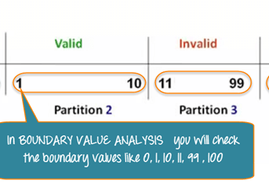
Boundary Value Analysis technique
It is one among the useful and critical Black box testing technique that helps in equivalence partitioning. BVA helps in testing any software having a boundary or extreme values.
This technique can identify the flaws of the limits of the input values rather than focusing on the range of input value. Boundary Value Analysis also deals with edge or extreme output values.

Slide 9
Equivalence Partitioning technique
Equivalent Class Partitioning allows you to divide set of test condition into a partition which should be considered the same. This software testing method divides the input domain of a program into classes of data from which test cases should be designed.
The concept behind this technique is that test case of a representative value of each class is equal to a test of any other value of the same class. It allows you to Identify valid as well as invalid equivalence classes.
Example:
Input conditions are valid between
1 to 1000
Hence there are five equivalence classes
1 to 9 - Units
10 to 99 - Tens
100 to 999 – Hundreds
1000 to 9999 - Thousands
You select values from each class, i.e.,
1 to 9 single value
10 to 99 single value
100 to 999 single value
1000 to 9999 invalid we can select only 1000

Slide 10

Decision Table technique
A decision table is also known as to Cause-Effect table. This software testing technique is used for functions which respond to a combination of inputs or events. For example, a submit button should be enabled if the user has entered all required fields.
The first task is to identify functionalities where the output depends on a combination of inputs. If there are large input set of combinations, then divide it into smaller subsets which are helpful for managing a decision table.

Slide 11

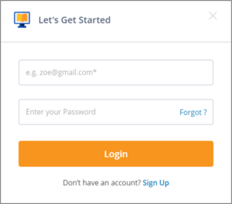
Example of Decision Table
A Decision Table is a tabular representation of inputs versus rules, cases or test conditions. Let’s take an example and see how to create a decision table for a login screen:

Slide 12

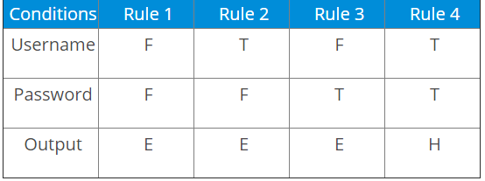
Decision table
The condition states that if the user provides the correct username and password the user will be redirected to the homepage. If any of the input is wrong, an error message will be displayed.

Slide 13
Example description
T – Correct username/password
F – Wrong username/password
E – Error message is displayed
H – Home screen is displayed
Now let’s understand the interpretation of the above cases:
Case 1 – Username and password both were wrong. The user is shown an error message.
Case 2 – Username was correct, but the password was wrong. The user is shown an error message.
Case 3 – Username was wrong, but the password was correct. The user is shown an error message.
Case 4 – Username and password both were correct, and the user is navigated to the homepage.

Slide 14

State Transition
In State Transition technique changes in input conditions change the state of the Application Under Test (AUT). This testing technique allows the tester to test the behavior of an AUT. The tester can perform this action by entering various input conditions in a sequence. In State transition technique, the testing team provides positive as well as negative input test values for evaluating the system behavior.
Guideline for State Transition:
State transition should be used when a testing team is testing the application for a limited set of input values.
The technique should be used when the testing team wants to test sequence of events which happen in the application under test.

Slide 15
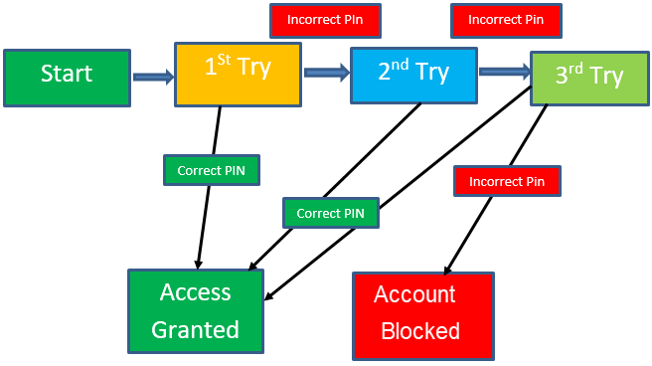
Example:
In the following example, if the user enters a valid password in any of the first three attempts the user will be able to log in successfully. If the user enters the invalid password in the first or second try, the user will be prompted to re-enter the password. When the user enters password incorrectly 3rd time, the action has taken, and the account will be blocked.

Slide 16
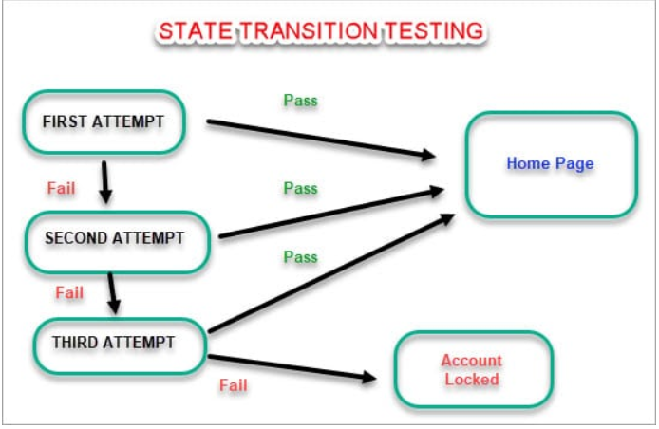
State Transition Table

Slide 17
Error Guessing
Error guessing is a software testing technique which is based on guessing the error which can prevail in the code. It is an experience-based technique where the test analyst uses his/her or experience to guess the problematic part of the testing application.
The technique counts a list of possible errors or error-prone situations. Then tester writes a test case to expose those errors. To design test cases based on this software testing technique, the analyst can use the past experiences to identify the conditions.

Slide 18
Guidelines for Error Guessing:
The test should use the previous experience of testing similar applications
Understanding of the system under test
Knowledge of typical implementation errors
Remember previously troubled areas
Evaluate Historical data & Test results

Slide 19
Few common mistakes that developers usually forget to handle:
Divide by zero.
Handling null values in text fields.
Accepting the Submit button without any value.
File upload without attachment.
File upload with less than or more than the limit size.

